Slide 1
FE 590 Introduction to Knowledge Engineering Course Project: S&P 500 Index Price level Prediction
By Chuhan Lin
Prof. Mahmoud Daneshmand
Financial Engineering
School of Systems and Enterprises
Stevens Institute of Technology

Slide 2
Outline
Introduction (Research Understanding phase)
Data (Data understanding & data preparation phases)
ANN Model (Modeling phase)
Results (Evaluation phase)
Comparison
Conclusion

Slide 3
Introduction
Index prediction has always drawn enough attention in the field of finance and economics studies.
Numerous Exchange Traded Funds (ETFs) track the performance of market indices.
Given the non-linear relation between different indices, artificial neural network model is a rational candidate for modeling the movement of indices.
This project intends to predict the monthly price level of the S&P 500 index.

Slide 4
DATA
Input Data
CPI - Consumer Price Index which would be a good proxy of inflation of the country IP - Industrial Production which could be considered as the proxy of the strength of the country’s economy
GDP GHNG - Gross Domestic Production quarter of quarter change GDP – Gross Domestic Pro
CLI – Composite Leading Indicator published by Organization for Economic Co-operation and Development (OECD) as a proxy to the industrial growth level of a country
PMI – Purchasing Managers Index which is the confidence index to the manufacturing point of view
DAX – Deutsche Borse AG German Stock Index
DOW - Dow Jones Industrial Average Index
SH COMP - Shanghai Stock Exchange Composite Index
TPX - Tokyo Stock Exchange Tokyo Price Index
MA – Moving average of the index itself, which would also be a reasonable predictor of directional movement of the index

Slide 5
DATA
Output data
S&P 500 Index - Output of the model is the prediction of the price of Standard & Poor 500 Index
Sample data ( Source: Bloomberg)
 | CPI | IP | GDP CHNG | GDP | CLI | PMI | DAX | DOW | SH COMP | TPX | MA
1/31/2000 | 0.3 | 91.3003 | 1.1 | 6.1 | 0.001976 | 56.7 | 6835.6 | 10940.54 | 1534.997 | 1707.96 | 1439.14333
2/29/2000 | 0.6 | 91.6338 | 1.1 | 6.1 | 0.002392 | 55.8 | 7644.55 | 10128.31 | 1714.578 | 1718.94 | 1457.20333
3/31/2000 | 0.7 | 92.001 | 1.1 | 6.1 | 0.001988 | 54.9 | 7599.39 | 10921.93 | 1800.225 | 1705.94 | 1442.54333
4/30/2000 | 0 | 92.5724 | 8 | 7.5 | 0.001722 | 54.7 | 7414.68 | 10733.92 | 1836.321 | 1648.87 | 1435.34333
5/31/2000 | 0.1 | 92.7012 | 8 | 7.5 | 0.00136 | 53.2 | 7109.67 | 10522.34 | 1894.554 | 1522.84 | 1467.70333
6/30/2000 | 0.4 | 92.7786 | 8 | 7.5 | 0.001003 | 51.4 | 6898.21 | 10447.9 | 1928.106 | 1591.6 | 1461.67333
7/31/2000 | 0.2 | 92.5586 | 0.3 | 6.5 | 0.000523 | 52.5 | 7190.37 | 10521.98 | 2023.539 | 1453.15 | 1461.19667
8/31/2000 | 0 | 92.3195 | 0.3 | 6.5 | 0.000116 | 49.9 | 7216.45 | 11215.1 | 2021.199 | 1511.44 | 1393.62
Monthly data from 2000/1/31-2012/9/30 are downloaded as input data for the model. There are 153 data points for each single input data. Considering the validity of model, all the input data will be lagged 1 month in training, which means the data of month i will be used to forecast the price of S&P 500 in month i+1.

Slide 6
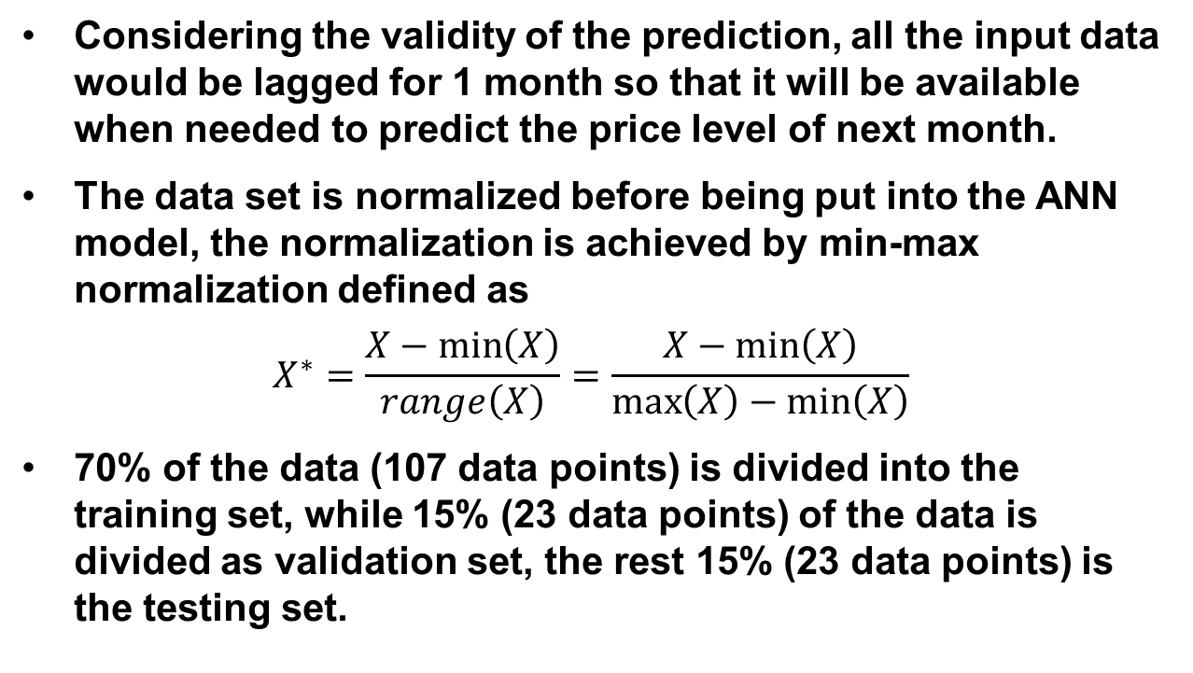
DAta
Considering the validity of the prediction, all the input data would be lagged for 1 month so that it will be available when needed to predict the price level of next month.
The data set is normalized before being put into the ANN model, the normalization is achieved by min-max normalization defined as
$$X^{∗}=\frac{X−\min\left(X\right)}{range\left(X\right)}=\frac{X−\min\left(X\right)}{\max\left(X\right)−\min\left(X\right)}$$
70% of the data (107 data points) is divided into the training set, while 15% (23 data points) of the data is divided as validation set, the rest 15% (23 data points) is the testing set.

Slide 7
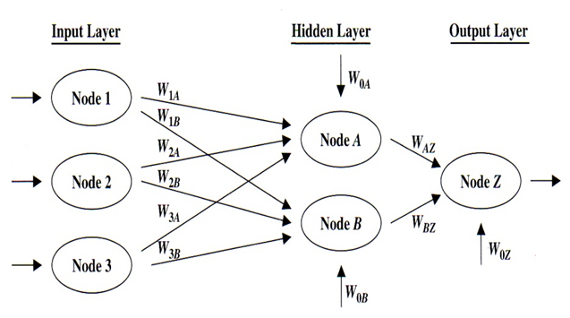
ANN Model

Slide 8
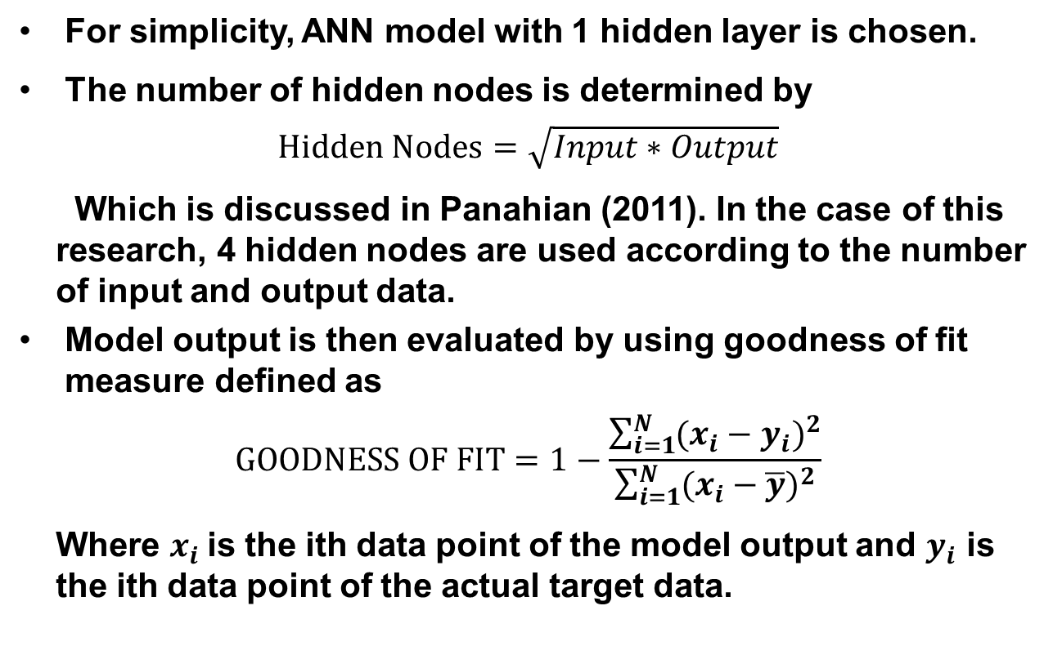
Ann model
For simplicity, ANN model with 1 hidden layer is chosen.
The number of hidden nodes is determined by
$$Hidden Nodes=\sqrt{Input∗Output}$$
Which is discussed in Panahian (2011). In the case of this research, 4 hidden nodes are used according to the number of input and output data.
Model output is then evaluated by using goodness of fit measure defined as
$$GOODNESS OF FIT=1−\frac{\sum_{i=1}^{N}{(x_{i}−y_{i})^{2}}}{\sum_{i=1}^{N}{(x_{i}−\overline{y})^{2}}}$$
Where $x_{i}$is the ith data point of the model output and $y_{i}$ is the ith data point of the actual target data.

Slide 9
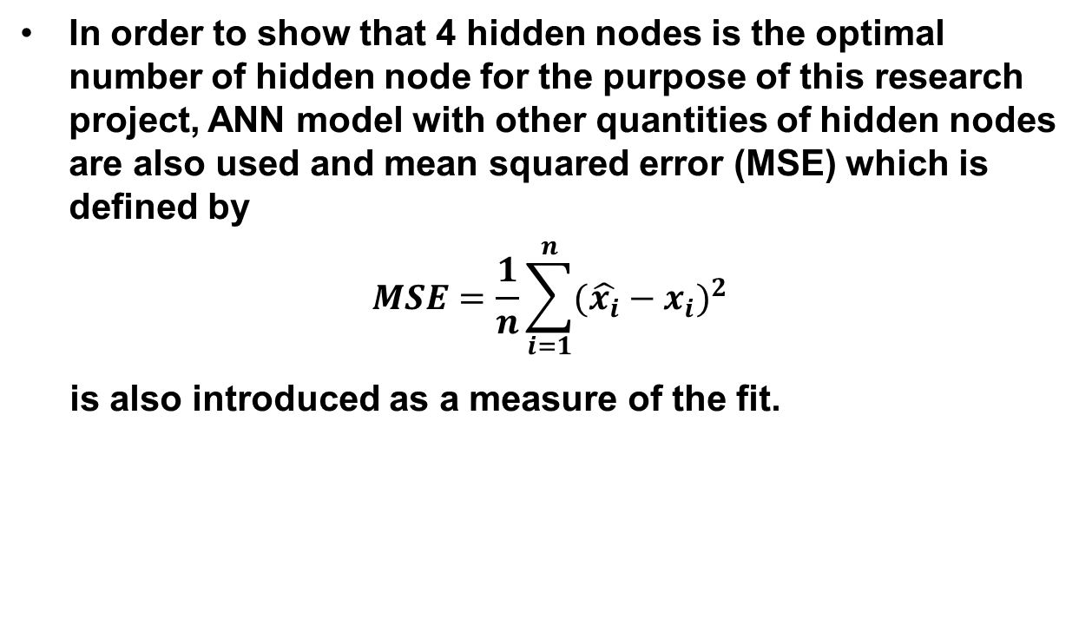
ANN Model
In order to show that 4 hidden nodes is the optimal number of hidden node for the purpose of this research project, ANN model with other quantities of hidden nodes are also used and mean squared error (MSE) which is defined by
$$MSE=\frac{1}{n}\sum_{i=1}^{n}{(\hat{x_{i}}−x_{i}})^{2}$$
is also introduced as a measure of the fit.

Slide 10
Result
The table below shows the result of the model calculated by MATLAB:
Hidden Layers | Hidden Nodes | Learning Rate | MSE | Goodness of Fit
1 | 3 | 0.03 | 757.27 | 0.98497
1 | 4 | 0.03 | 747.35 | 0.98521
1 | 12 | 0.03 | 1017.11 | 0.98013
1 | 14 | 0.03 | 1825.11 | 0.96434
1 | 20 | 0.03 | 2826.53 | 0.94445
It is shown in the above table that the ANN model with 4 hidden nodes has the smallest MSE and largest goodness of fit among all the models with different node hence it is the optimal model for this study.

Slide 11
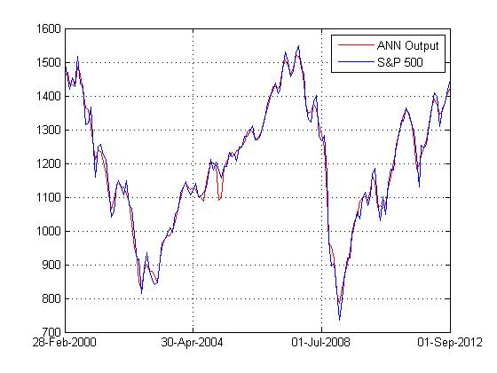
result
The plot of ANN model output (4 hidden nodes) against real S&P 500 Index:

Slide 12
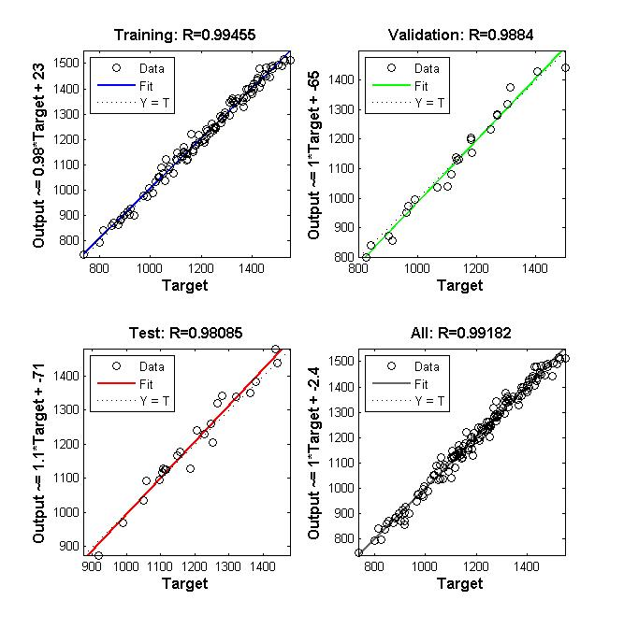
result
Regression plot of ANN model output against target (S&P 500), price against price at all time. The high R value shows that the ANN model generates a satisfying prediction.

Slide 13
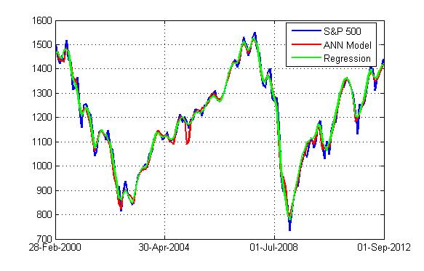
Comparison
In order to further demonstrate the prediction ability of the ANN model, a classical multivariate regression is performed and compared to the results of using ANN model.
The goodness of fit measure for the regression model is 0.9837 and that of the ANN model is 0.9852.

Slide 14
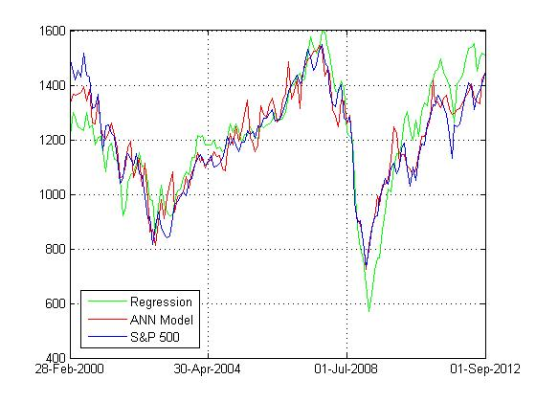
Comparison
To take the comparison further, all the market indices are taken away (reducing the correlation between input and target) from the input and both of the models are re-calculated.
Here, the goodness of fit measure for the regression model is 0.6667, while that of the ANN model is 0.8989.
The prediction ability of the multivariate regression model reduce significantly when the correlation between input and target is reduced.

Slide 15
Conclusion
When choosing the number of hidden layers and hidden nodes properly, ANN shows a fairly well ability to model target series with certain inputs.
If the input is highly correlated to the target, both ANN and traditional multivariate regression could generate satisfying results.
When the input and target are less correlated, ANN displays a much better accuracy in prediction than traditional multivariate regression.

Slide 16
Reference
Chen, A.-S., Leung, M. T., & Daouk, H. (2003). Application of neural networks to an emerging financial market: forecasting and trading the Taiwan Stock Index. Computers & Operations Research, 901-923.
Larose, D. T. (2005). Discovering knowledge in data. Hoboken: John Wiley & Sons.
Panahian, H. (2011). Stock market index forecasting by neural networks models and nonlinear multiple regression modeling: Study of Iran's Capital Market. American Journal of Scientific Research, 35-51.

Slide 17
Thank you

